Slide 1
20/20 Analytics
Strategic Political Solutions

Slide 2
20/20 Analytics
Political Consulting
Data Driven
Adaptive
Competitively Priced
Who we are
Notes:
20/20 hindsight
2020 Political campaign

Slide 3
Our Team
Dong He
Michal Motykiewicz
Josh Orenstein
Elyse Richardson
Allen Weng

Slide 4
Political Data Solutions

Slide 5

How to Develop an Effective Marketing Campaign?
A direct mail marketing campaign is effective, but expensive. It’s important to spend your budget efficiently, but with the overabundance of information, how do you narrow down and develop your mail strategy?
$
Notes:
Problem Statement

Slide 6
How 20/20 Can Help Your Campaign
Historical research database access
Ability to evaluate the real value of a direct mail list
Guidance on most efficient method to spend direct mail money
Location based digital adword targeted marketing
Notes:
Historical research database access
Ability to evaluate the real value of a direct mail list > is it really worth the money
How to efficiently spend your direct mail money > what zip codes/counties to target first
Digital Marketing > location based adword targeting

Slide 7
The 20/20 Approach
4.7 mil verified rows!
We’ve taken about 7 million of rows of data collected from multiple sources:
US Census Data*
Federal Election Commission Database**
2012-2016 County by County Election Results***
The information leveraged included:
Donor occupation, zip code, candidate, and donation size
County population, education, income, household size & more
*http://www.census.gov **http://www.fec.gov/finance/disclosure/norindsea.shtml ***www.nytimes.com
6 Donor Files!

Slide 8
The 20/20 Methodology
Methodology:
Retrieve and bin data
Join data frames on zip code and county data
Assign tags based on political candidate
Create classes and lambda functions to score candidates’ performance
Training data
Run regressions and additional statistical analyses
Plot results to visualize data
Libraries & Tools used:
Pandas
Plotting (matplot)
Stats Models
SciKit (sklearn)
Pickle
Numpy
CSV Reader

Slide 9
20/20 Campaign Tool Set
Database: comprehensive election and donation data
Search engine: ability to query election donations
Analysis: grouping of high-medium-low contributions by political party
Data Mining: analytical hindsight of 2016 national election
Voter Micro Targeting: scoring counties based on 2016 election results

Slide 10
Campaign Tool Set
Total Raised
Find how much money was donated by Occupation
Find how much money was donated by Zip Code
See List of Donations for an Employer
See total donations for zip code
Plot donations by state
Donations by $ value
Top 20 Donations by Candidate
Find total in dataset
Find best/worst states to fundraise in
Find Low, Medium, High Donor Employers/Counties
Data Mining Tools for Voting Data
Features

Slide 11
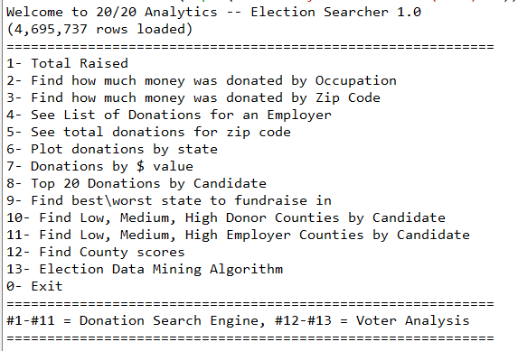
PROGRAM DEMO
Notes:
Load & precompile (Michal)
Lambdas “search engine (Michal)
High-medium-low (Alan) > if we work with republicans, we recommend….
Statistical data (Josh)
Micro targeting County scoring (Dong)

Slide 12
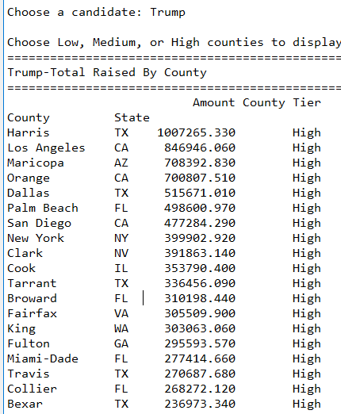
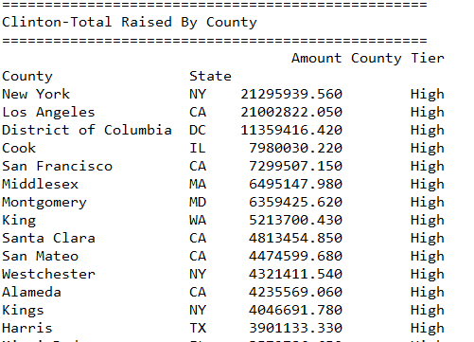
Feature 11: Low-Med-High Counties by Candidate

Slide 13
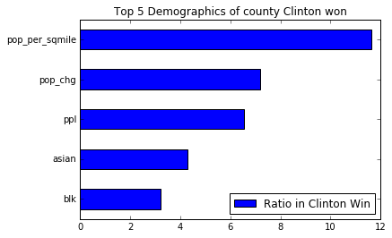
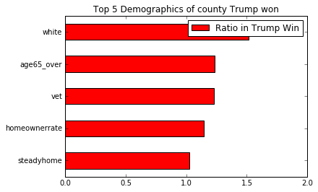
Data Mining Results

Slide 14
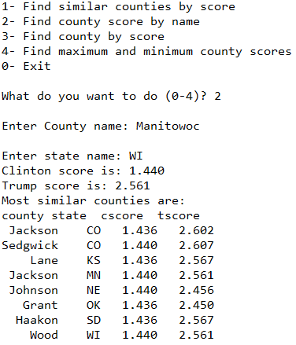
County Scores

Slide 15
Questions?
20/20 Analytics

